Slide 1
School management system
By
Srinivasa Pavan Ganesh Vasa
Dharma Thanishq Nimmala
Rushikesh Karwankar

Slide 2
contents
Problem Definition
Problem statement
Work Flow
Login page
Wrong password
Admin Dashboard
Departments
Manage students
Manage courses
Statistics
Student login
Student dashboard
Absent or Present
Tools and Topics from class

Slide 3
Problem definition
The Student Management System is an application that aims to simplify the management of student records in educational institutions. This system is designed to provide a user-friendly interface that enables teachers and administrators to store, manage, and retrieve student records easily. The system should include modules for student registration, course management, course statistics.

Slide 4
Problem statement
The current manual process of managing student records in educational institutions is time-consuming and prone to errors. The need for an efficient and reliable system that can manage student records has become a necessity. The purpose of this project is to design and develop a Student Management System using JavaFX that can automate the process of managing student records in educational institutions. The system should provide an easy-to-use interface that allows administrators and teachers to manage student records efficiently. This system should be capable of storing and managing student records, including course management, and other relevant information. The system should also be able to generate reports that can be used for decision-making purposes. The successful implementation of this project will lead to an efficient and reliable system for managing student records in educational institutions.

Slide 5
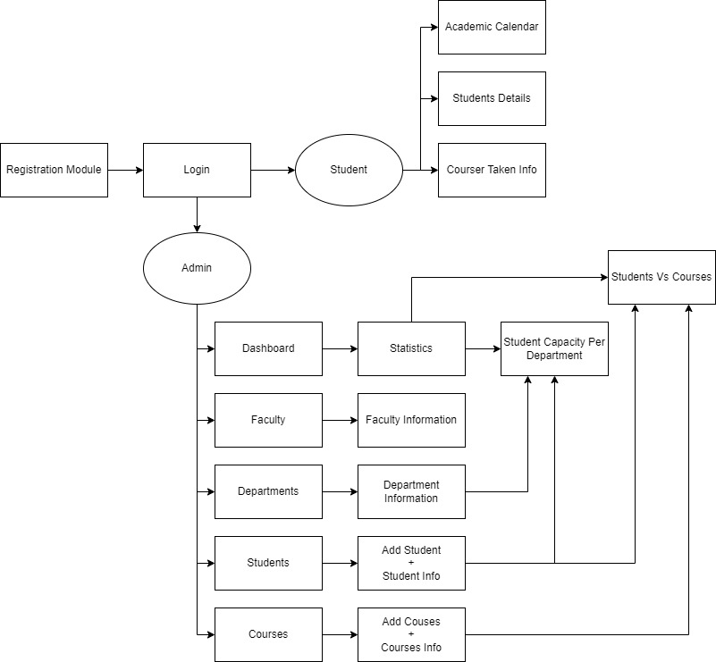
Work flow

Slide 6
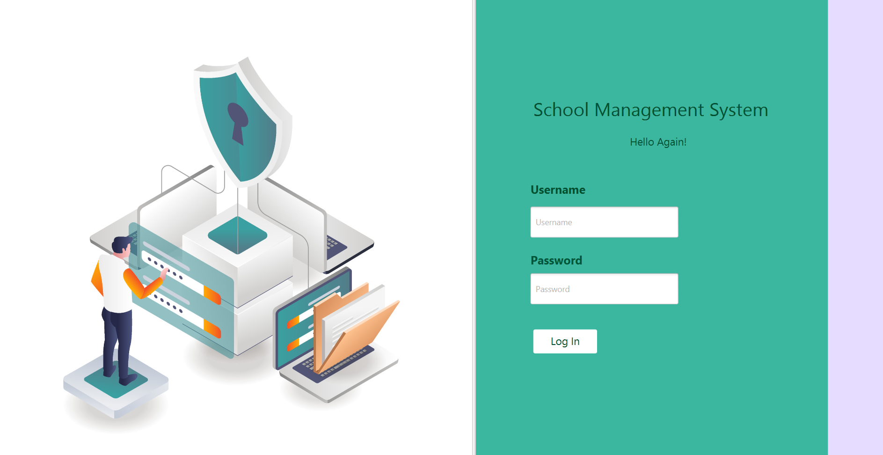
Login page
This is the login page where the admin and students can login using their credentials

Slide 7
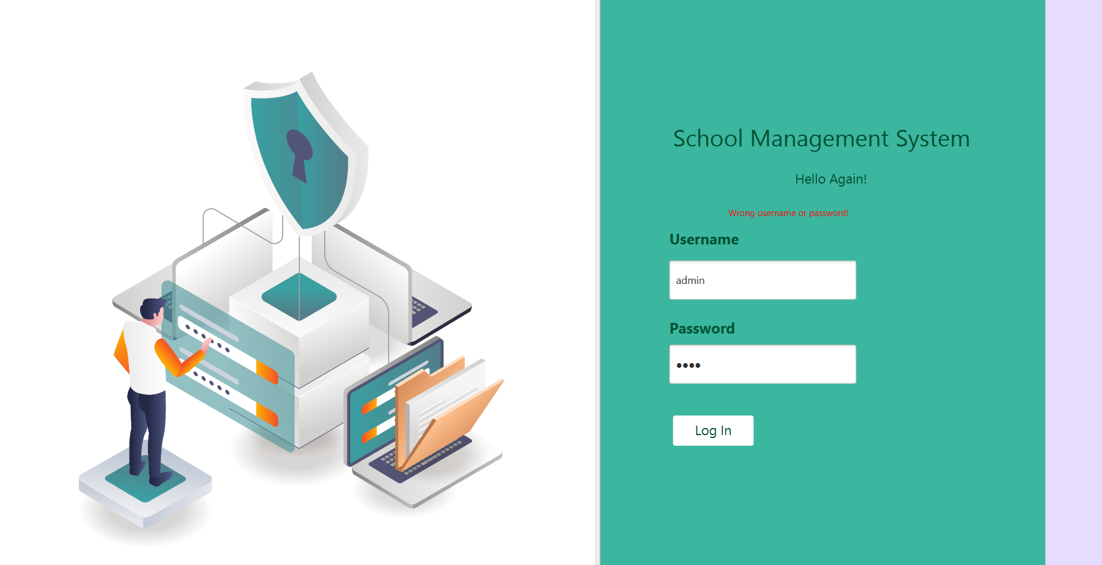
Wrong password
If we enter wrong or invalid credentials, an error message will be displayed stating “Wrong username or password”.

Slide 8
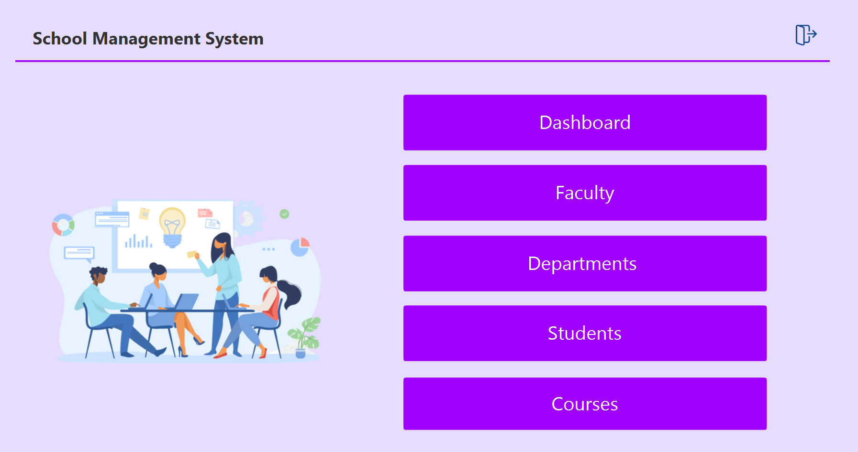
Admin dashboard
This is the admin dashboard, which appears after admin logs into the portal where admin can manage multiple sections like faculty, departments, and students, etc.

Slide 9
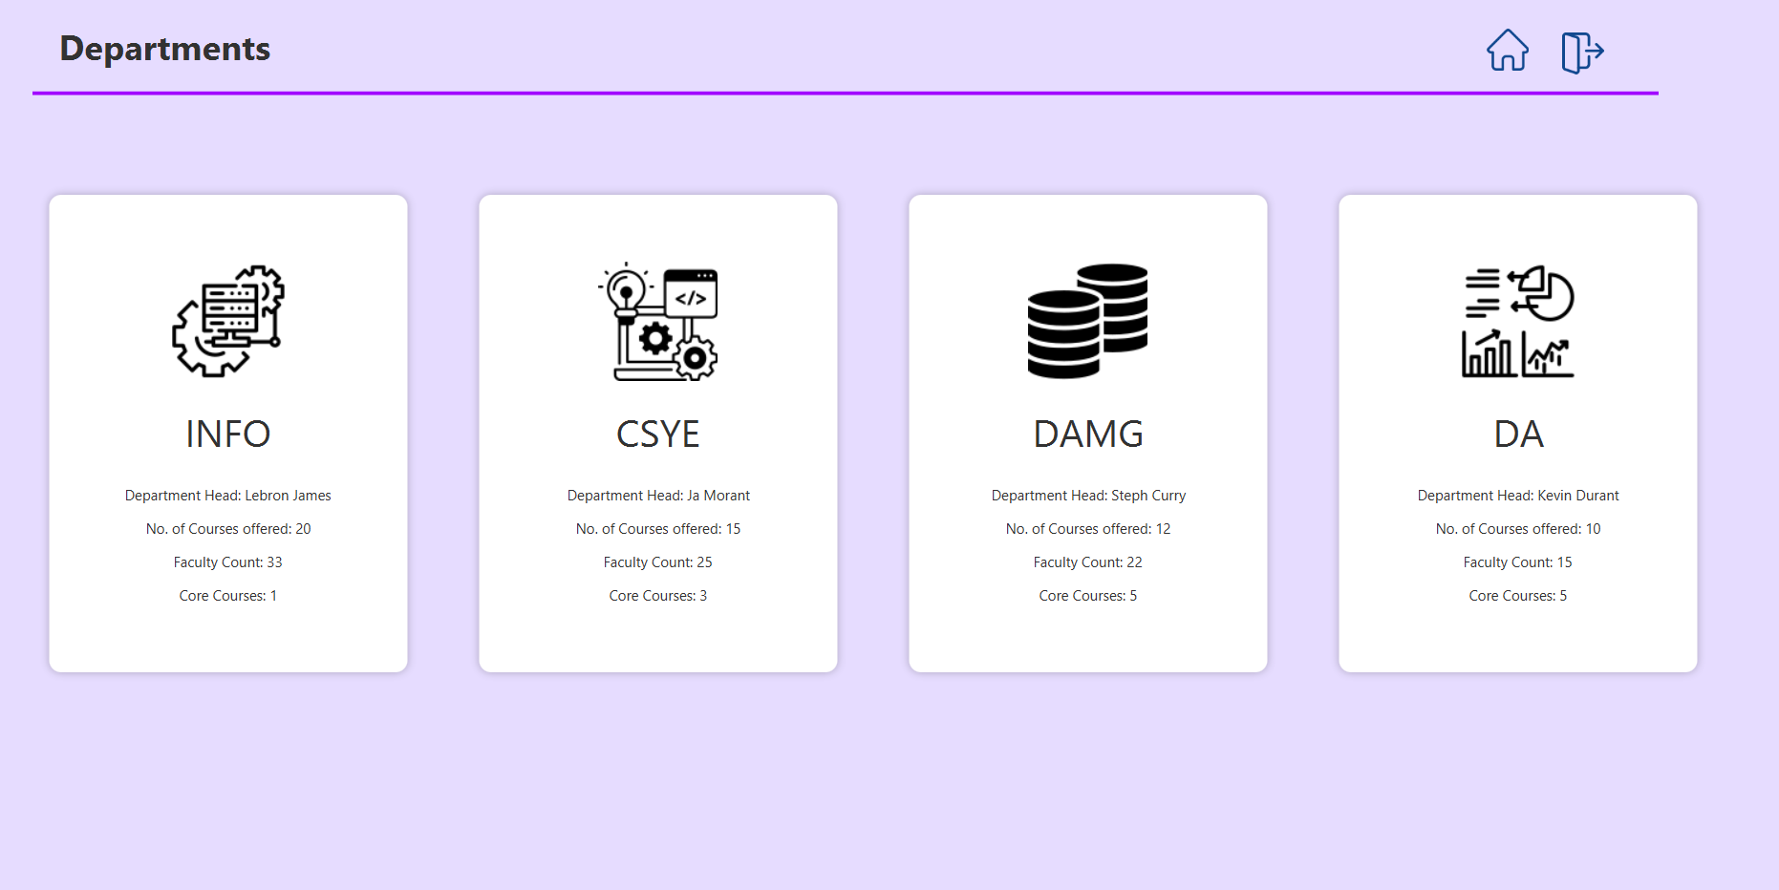
departments
This is the Departments section of the admin page where we can see all the departments that are available in the course work.

Slide 10
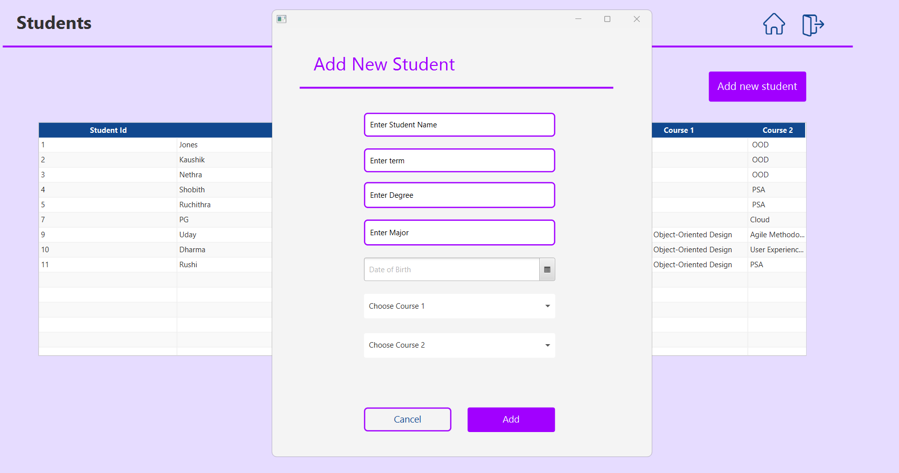
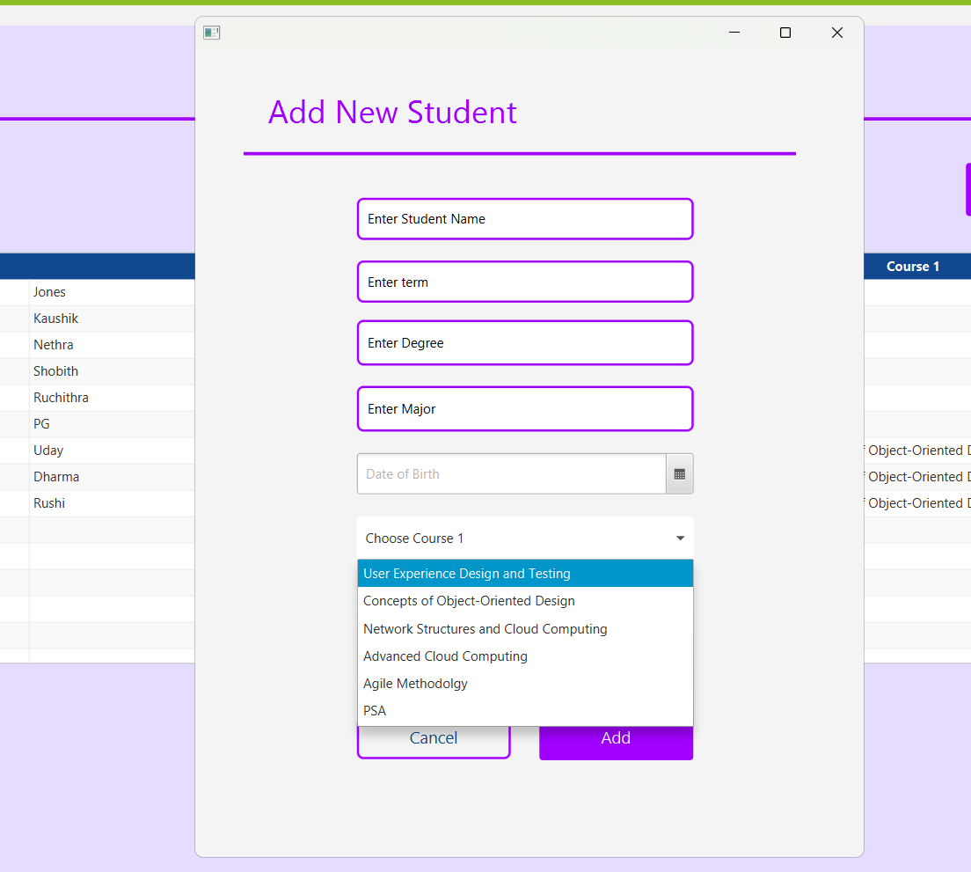
Manage student
We can add new student as shown in the images
He will be able to choose his course 1 and course 2 as shown in the image.

Slide 11
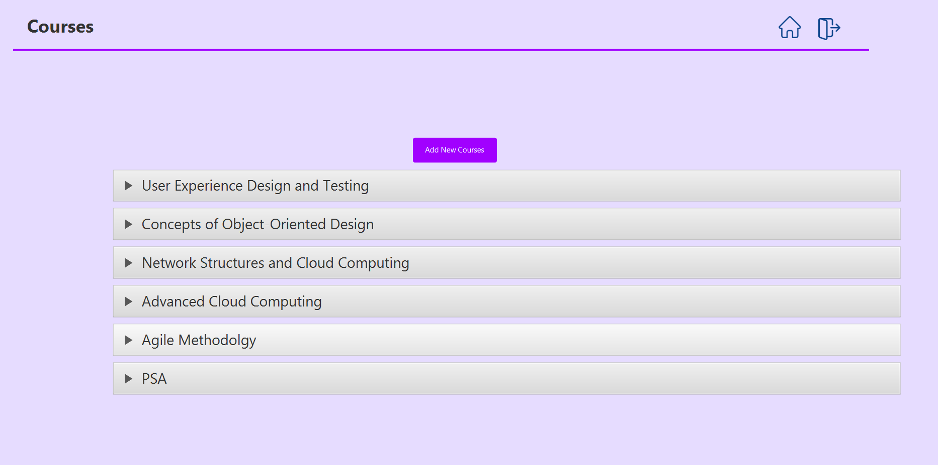
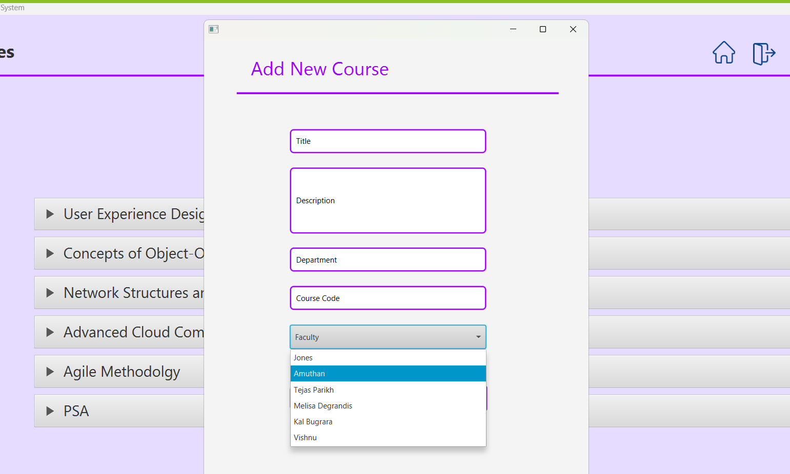
Manage courses
The admin will be able to add new courses as shown in the images above

Slide 12
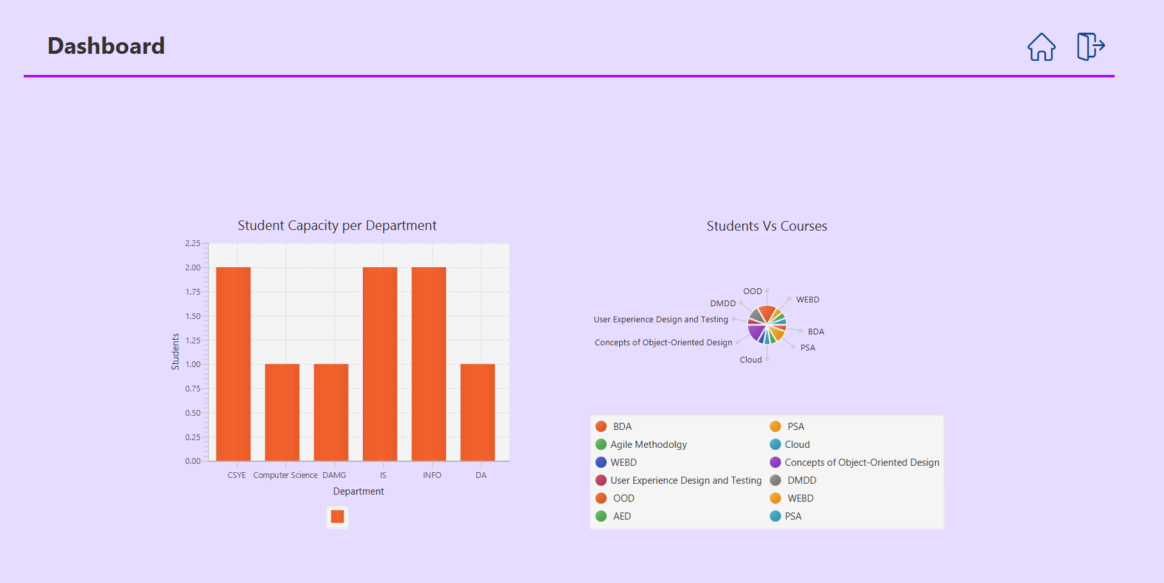
statistics
This page is shows the statistical information regarding the student capacity per department.
We can observe that most popular departments are CSYE, INFO, IS and the least popular are DAMG, DA and Computer Science.
Each course in a particular department is assigned a different colour which is visible on the legend.
The pie chart represents the volume of students present in each course.

Slide 13
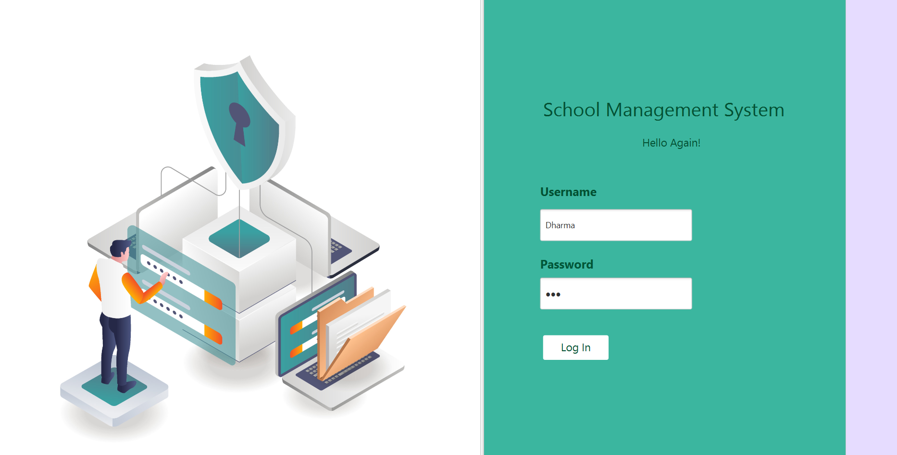
Student login
This is the student login.
The same login page is used for both admin and student login.

Slide 14
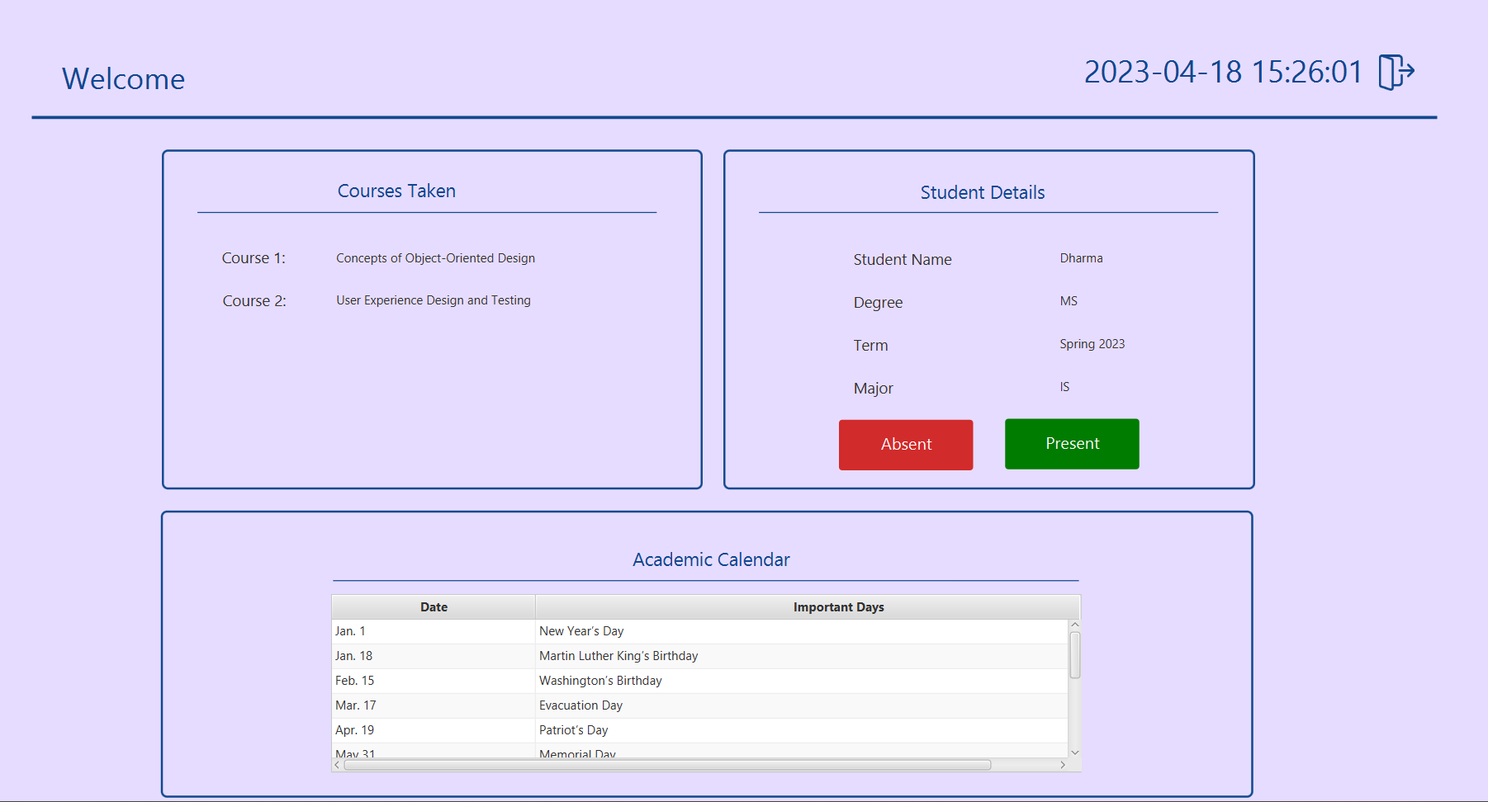
Student dashboard
Once the student is logged in, he will be able to see his dashboard consisting of multiple sections as following:
Student Details This section holds the student information including student name, degree, term and major.
Courses Taken The courses that the student have registered appears here.
Academic Calendar The list of all the important days are listed in this section.

Slide 15
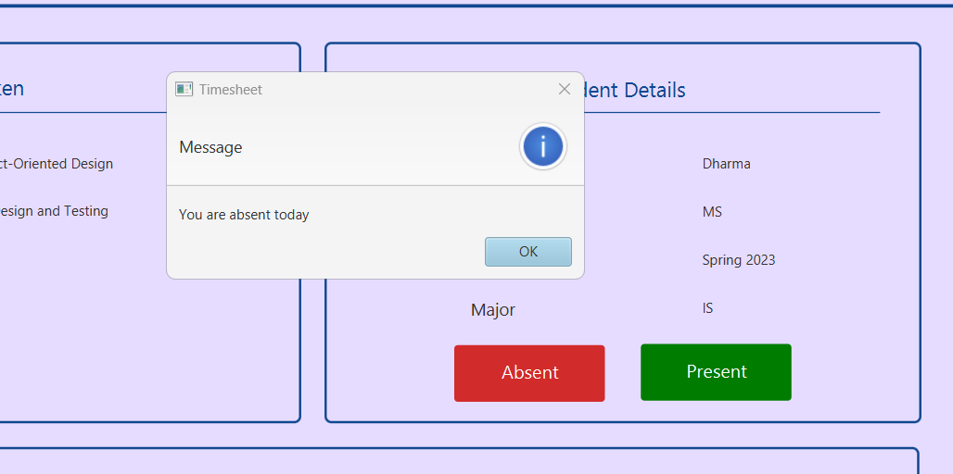
Absent or present
We have added two buttons namely Absent and Present which when clicked pops up a window consisting of a relevant message.

Slide 16
Tools and topics from class
Tools used
- Eclipse - Git repository - Git GUI - Scene Builder, Draw.io - Microsoft Word, Microsoft PowerPoint
Topics covered
- JavaFX - Class Definition - Inheritance/Polymorphism - Abstract Classes/Interfaces - Iterators - Lists

Slide 17
Work assigned
Srinivasa Pavan Ganesh Vasa - Courses, Students, Statistics
Dharma Thanishq Nimmala – Login Page, Student Dashboard
Rushikesh Karwankar – Departments, Faculty dashboard

Slide 18


